Slide 1
Team Project (June 24th, 2017)
Walmart Product Reviews in YouTube

Slide 2
The Team
Brandon Barulich and Leritha Pride
HTML and CSS – styling & dynamicity
Firebase data store integration
API integrations and challenges
Hoaly Nguyen and Nitu Roy Prodhani
HTML and CSS
JavaScript and components integration

Slide 3
What -
An application for one stop video reviews in YouTube for Walmart products
How –
Provides the user an interface to search for products,
Searches Walmart product catalogue to fetch the relevant products,
Fetches the top video review of each relevant product in YouTube,
Presents the user with one integrated view of the search results with details, and
Helps the user by remembering and presenting its last ten product search requests

Slide 4
Design Process –
Identified the layout and wireframe of the application,
Worked on determining the integration points - Walmart, YouTube & Firebase,
Understood the data structure being returned by the integration points,
Planned the event handling based on the data and subsequent UI blocks rendering,
Overcame the challenges associated with security like CORS (Cross Origin Resource Sharing),
Collaborated on integrating the individual contributions into the solution

Slide 5





Interplay
Technology Stack
HTML5
Bootstrap 3.3.7
JQuery 1.12.0
JQuery UI 1.12.0
CSS3
Ajax
Firebase 3.2.1
Google YouTube API
Walmart Labs API
User Interface
Integration

Slide 6
Future -
Integration with product APIs from other retailers for a more comprehensive view,
User registration and login functionality with a navigation bar,
Offer an option of email alerts to registered users upon a product price drop with a retailer,
Charts of price change history of the last five product searches,
Pagination of the search results, and
Link for written product reviews on the number of reviews information

Slide 7
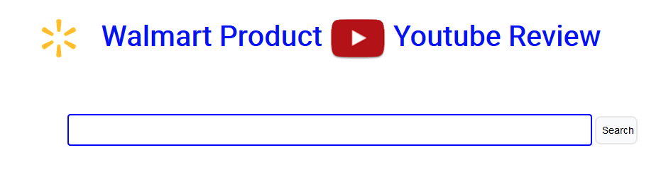
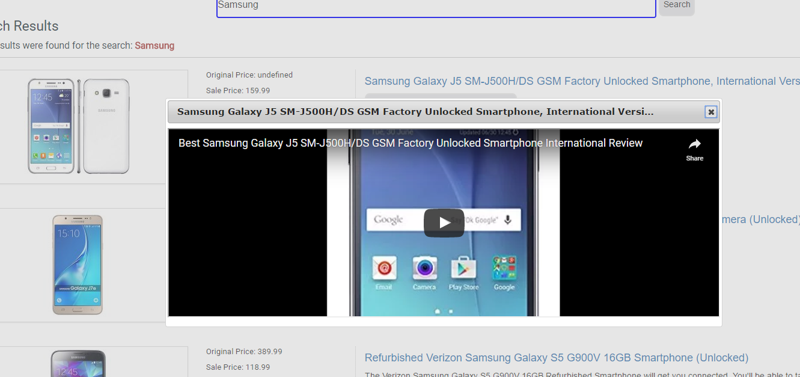
Demo

Slide 8
Thank you

